Slide 1

A 28nm 64kb Bit-Rotated Hybrid-CIM Macro with an Embedded Sign-Bit-Processing Array and a Multi-Bit-Fusion Dual-Granularity Cooperative Quantizer
B11901027 王仁軒
PPT TemplateCredit : Jie-Hong Roland Jiang

Slide 2
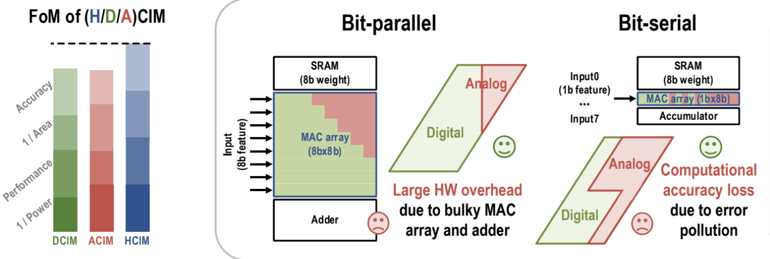
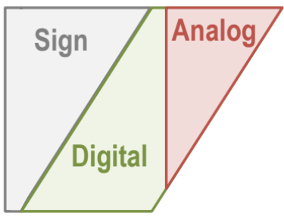

Motivation & Challenge
Hybrid CIM
Balance between DCIM and ACIM
Challenge1 : definition problem of boundary between digital and analog part
Challenge2 : more expensive overhead of sign-bit processing on digital part
Challenge3 : energy wasted on low-accuracy-contributed quantization on analog part

Slide 3
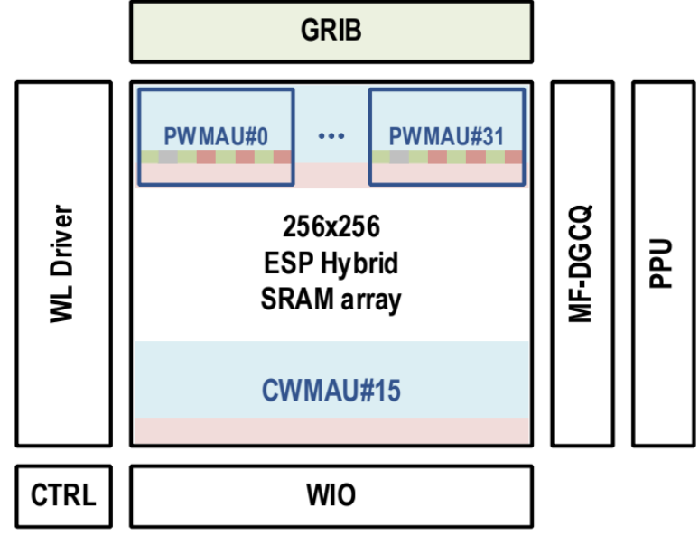
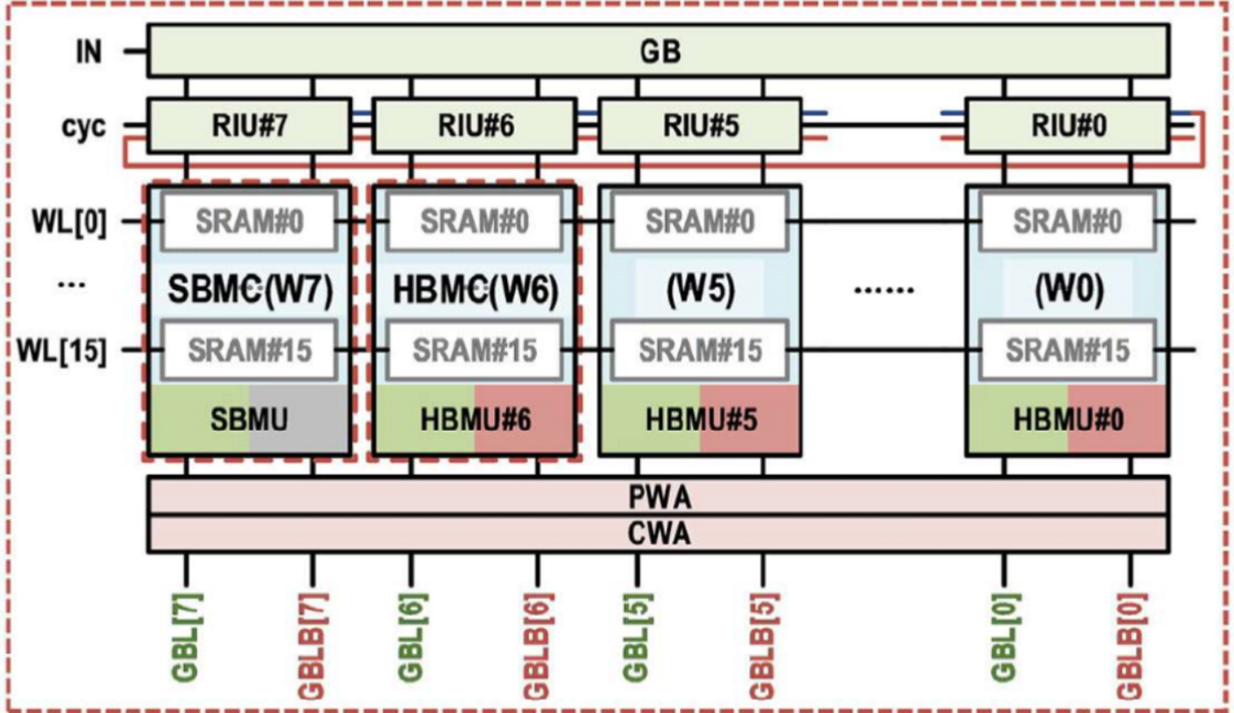

CIM Macro
Hybrid CIM macro

Slide 4
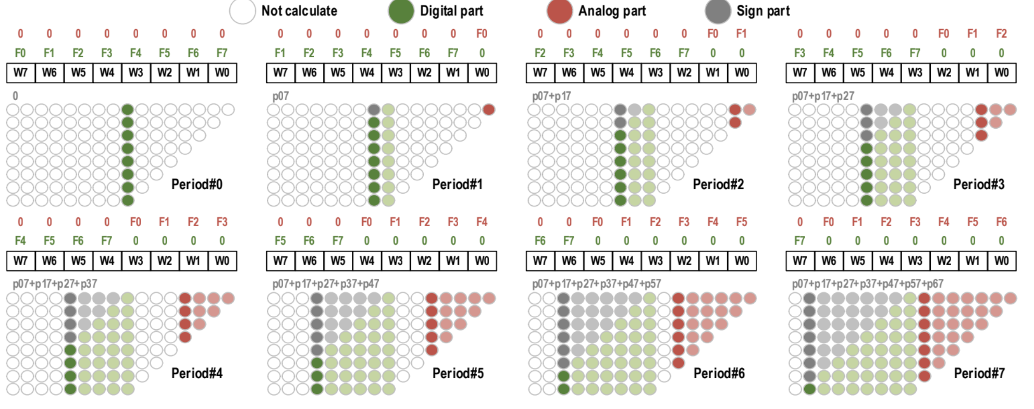
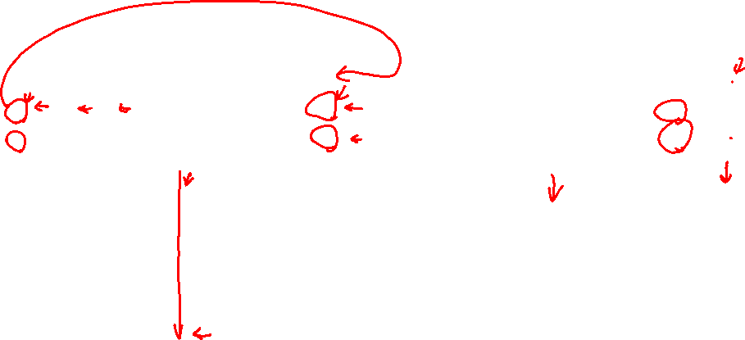
Proposed Scheme
Bit-rotated feature-in scheme
Low hardware overhead as bit-serial
High accuracy as bit-parallel

Slide 5

Proposed Scheme
Bit-rotated feature-in scheme
Low hardware overhead as bit-serial
High accuracy as bit-parallel

Slide 6
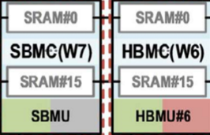
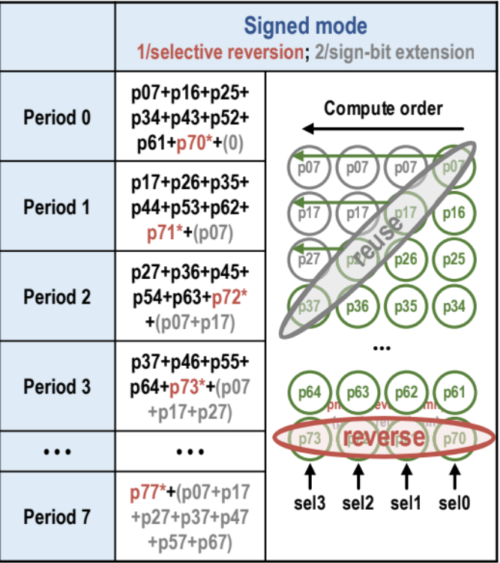
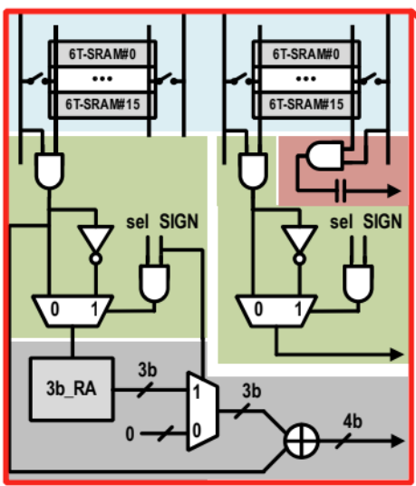
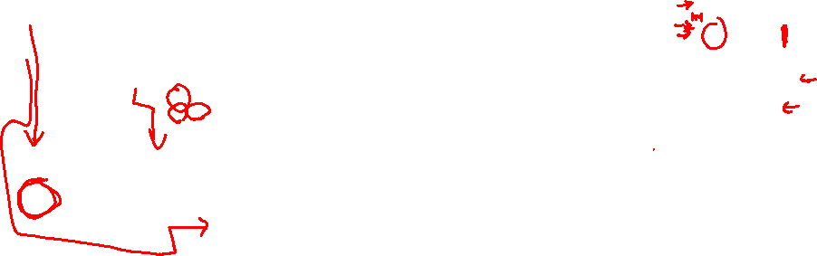
Proposed Scheme
Embedded sign-bit-processing hybrid array
1 0 1 1
1 1 0 0
+ 0 0 0 0 0 0 0
+ 0 0 0 0 0 0
+ 1 1 0 1 1
- 1 0 1 1

Slide 7
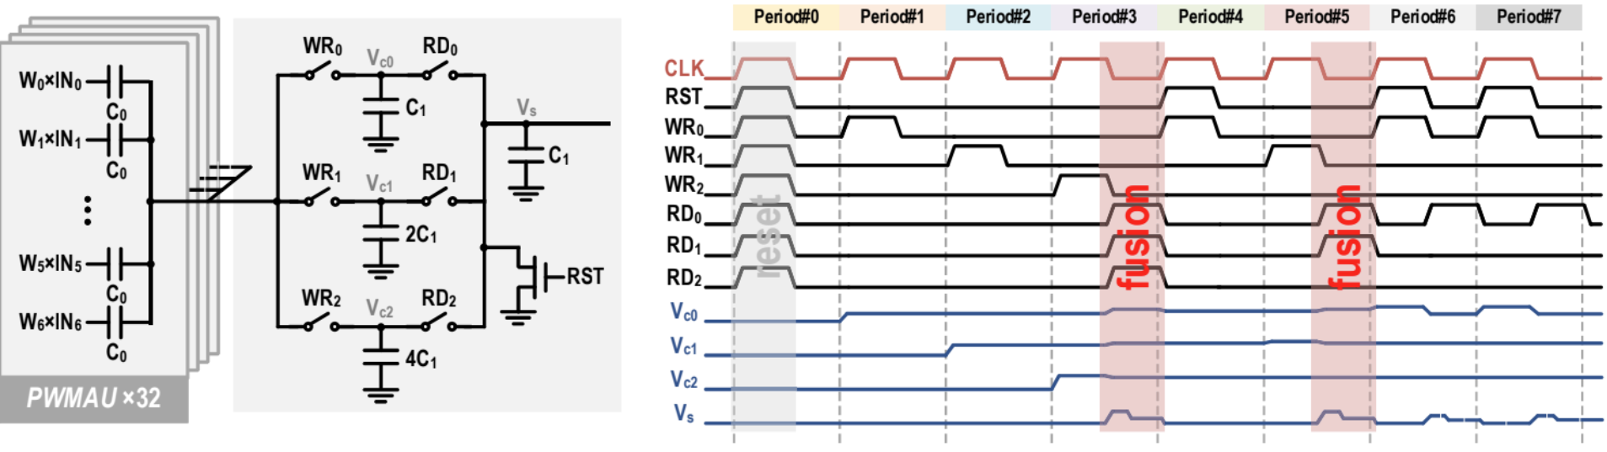


Proposed Scheme
Multi-bit-fusion
Period1 : $V_{c0}=\frac{C}{C+C_{1}}$, Period2 : $V_{c0}=\frac{C}{C+{2C}_{1}}$, Period3 : $V_{c0}=\frac{C}{C+{4C}_{1}}$
$V_{S}=\frac{V_{c0}⋅C_{1}+V_{c1}⋅{2C}_{1}+V_{c2}⋅{4C}_{1}}{C_{1}+C_{1}+2C_{1}+{4C}_{1}}$= $\frac{\left(V_{c0}+2V_{c1}+4V_{c2}\right)C_{1}}{{8C}_{1}}$

Slide 8
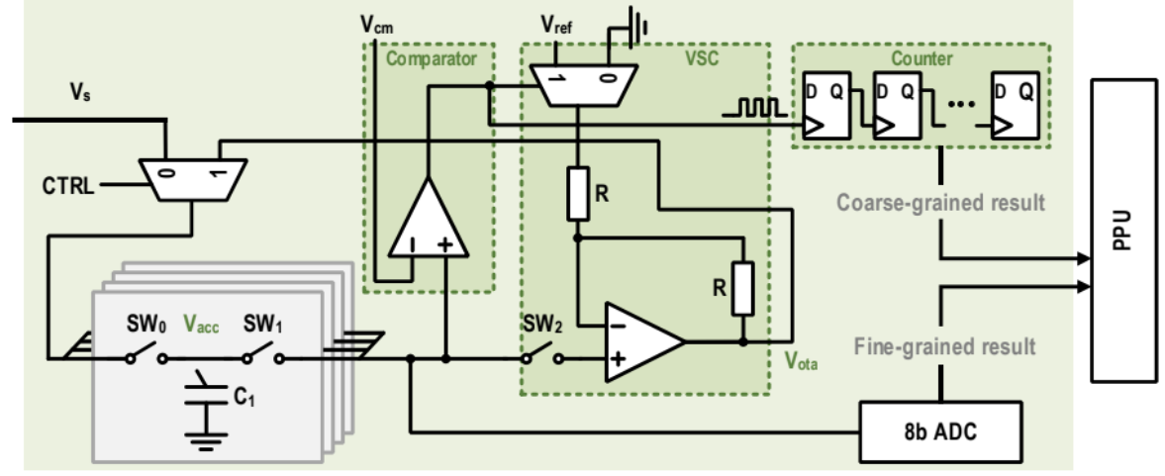
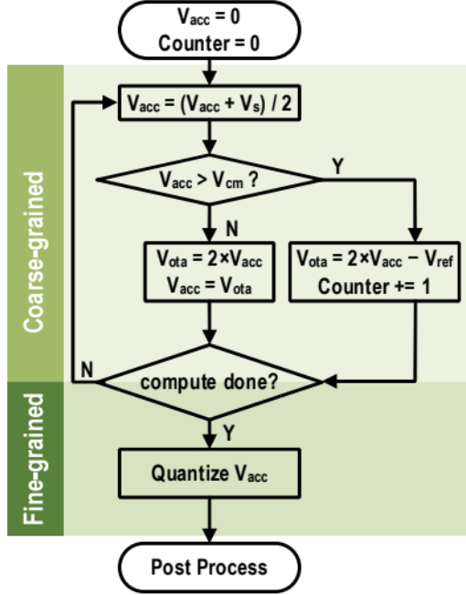
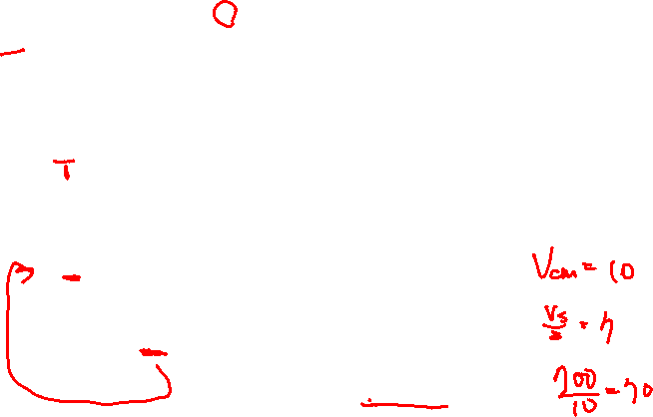
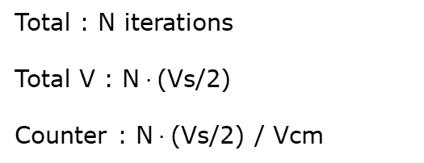

Proposed Scheme
Coarse/fine-grained quantizer
$$V_{acc}+=\frac{V_{s}}{2}$$
Total : N iterations
Total V : N$⋅$(Vs/2)
Counter : N$⋅$(Vs/2) / Vcm

Slide 9
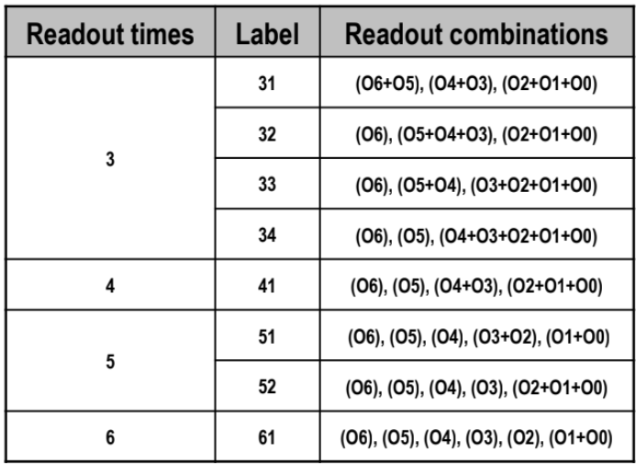
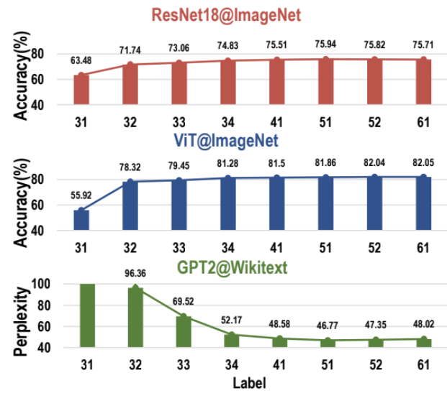
Results
Low accuracy loss but great energy reduction
4-times readout combination incurs almost no accuracy loss and outperforms 5/6-times readout combinations regarding energy consumption

Slide 10
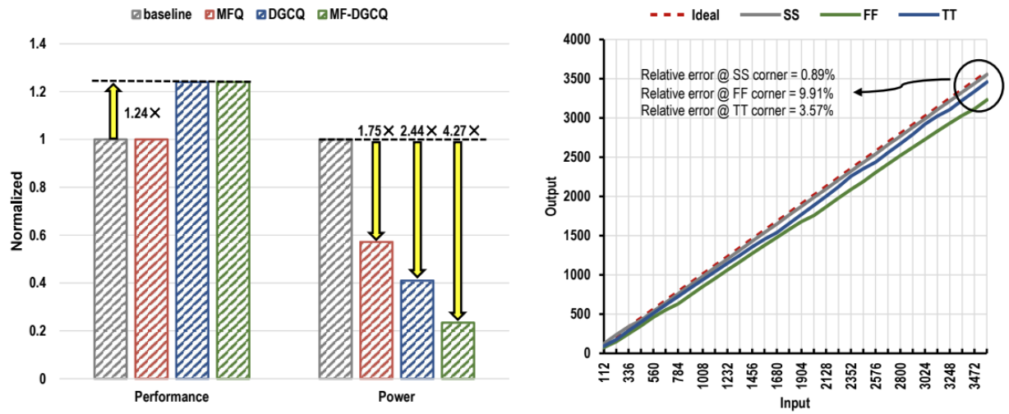

Results
MF-DGCQ achieves 24% performance enhancement and 4.27× power reduction with relative error of 3.57% in TT corner

Slide 11
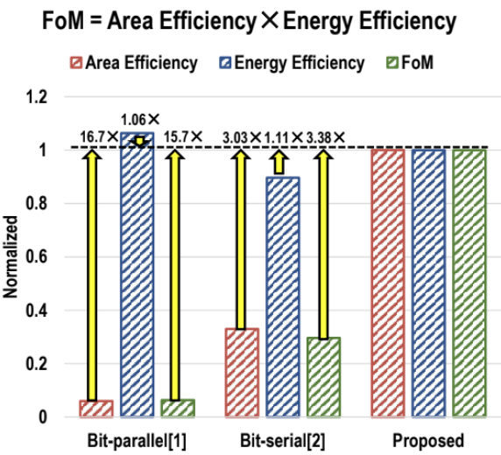
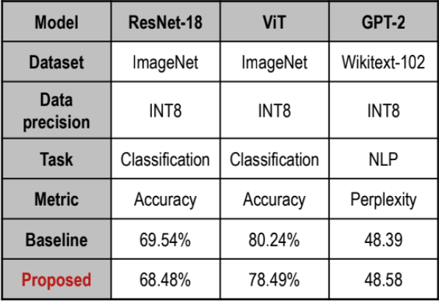
Results
This design outperforms typical bit-parallel / serial work on the FoM (area efficiency × energy efficiency) by 15.7× and 3.38×.
Accuracy loss -1.06% for ResNet-18@ImageNet, -1.75% for ViT@ImageNet, 0.19 for GPT-2@Wikitext-102.

Slide 12
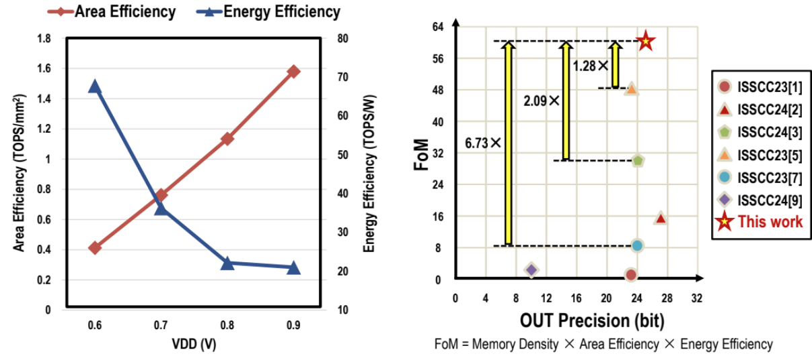
Results
21.04TOPS/W@0.9V, 1.57TOPS/mm2@0.9V.
Access time is 12ns@0.9V, 8bIN–8bW–21bOUT.

